Slide 1

Assessment, Analysis, and Hardening of a Vulnerable System
Capstone Engagement

Slide 2
Table of Contents
This document contains the following sections:
01
Network Topology
02
Red Team: Security Assessment
03
Blue Team: Log Analysis and Attack Characterization
Hardening: Proposed Alarms and Mitigation Strategies
04

Slide 3

Network Topology
3

Slide 4
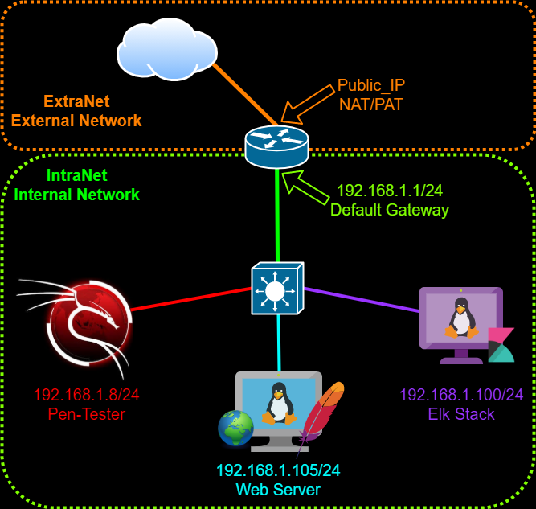
Network Topology
Network:
Address Range: 192.168.1.0/24 Netmask: 255.255.255.0 Gateway: 192.168.1.1
Machines:
IPv4: 192.168.1.8
OS: Kali Linux Hostname: kali
IPv4: 192.168.1.105
OS: Linux Hostname: server1
IPv4: 192.168.1.100
OS: Linux Hostname: ubuntu-headless

Slide 5

Red Team Security Assessment
5

Slide 6
Recon: Describing the Target
Nmap identified the following hosts on the network:
Hostname | IP Address | Role on Network
N/A | 192.168.1.1 | Gateway
ubuntu-headless | 192.168.1.100 | ELk Stack
server1 | 192.168.1.105 | Apache Web Server
Kali | 192.168.1.8 | PenTester Machine

Slide 7
Vulnerability Assessment
The assessment uncovered the following critical vulnerabilities in the target:
Vulnerability | Description | Impact
CWE-548: https://cwe.mitre.org/data/definitions/548.html | Directory listing: allows an attacker to browse through the directory structure of the system allowing them view potentially sensitive and confidential data. | Exposing the contents of a directory. Compromising private and confidential data.
CWE-307: https://cwe.mitre.org/data/definitions/307.html | Brute Force / Hydra: The software does not implement sufficient measures to prevent multiple failed authentication attempts within in a short time frame. | An attacker could perform an arbitrary number of authentication attempts using different passwords, and eventually gain access to the targeted account.
CWE: 98 https://cwe.mitre.org/data/definitions/98.html | Remote Code Execution: This vulnerability allows an attacker to remotely execute code, potentially granting them access to the system to to further infect it and gain persistence. | Successful exploitation of PHP file inclusion may result in information disclosure or compromise of the vulnerable system.

Slide 8
Exploitation: Directory Listing
01
02
03
No specific tools were used in this particular exploit. This is an exploit that takes advantage of a misconfiguration on a the website. Directory listing is a web server function that displays the directory contents when there is no index file in a specific website directory.
I was able to achieve access to the websites directories allowing me to browse through and perform reconnaissance.
No special command was used to exploit directory listing. All that is needed is an URL or IP Address to the web server. The following IP Address was entered into the browser: 192.168.1.105

Slide 9
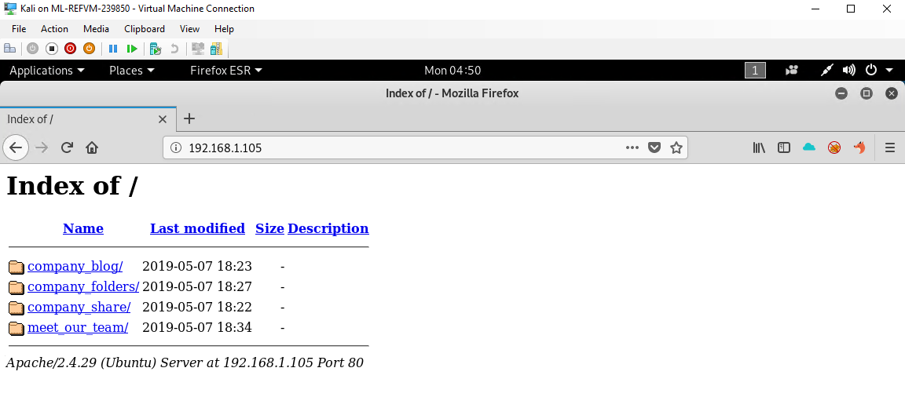
Directory Listing: Revealing Parent Directory

Slide 10
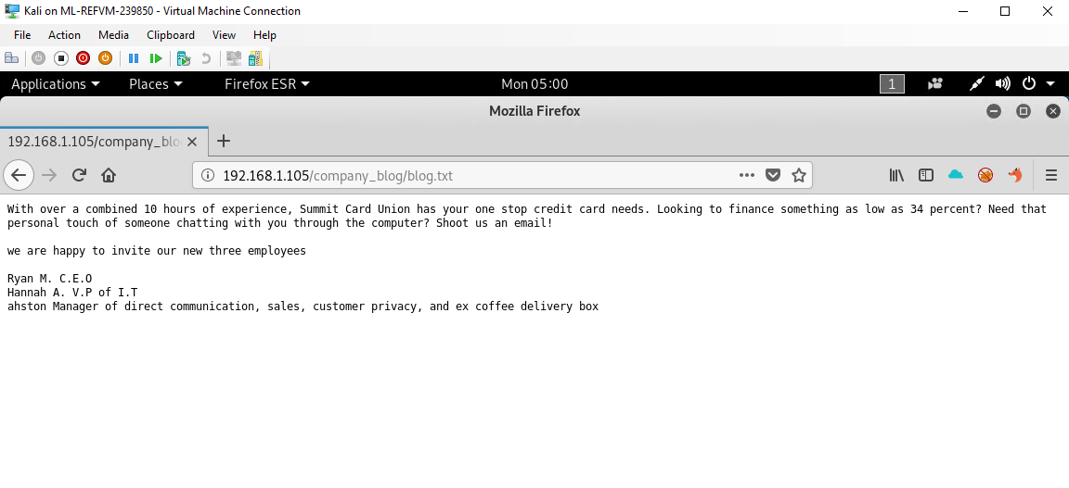
Directory Listing: Revealing Memo / E-mail

Slide 11
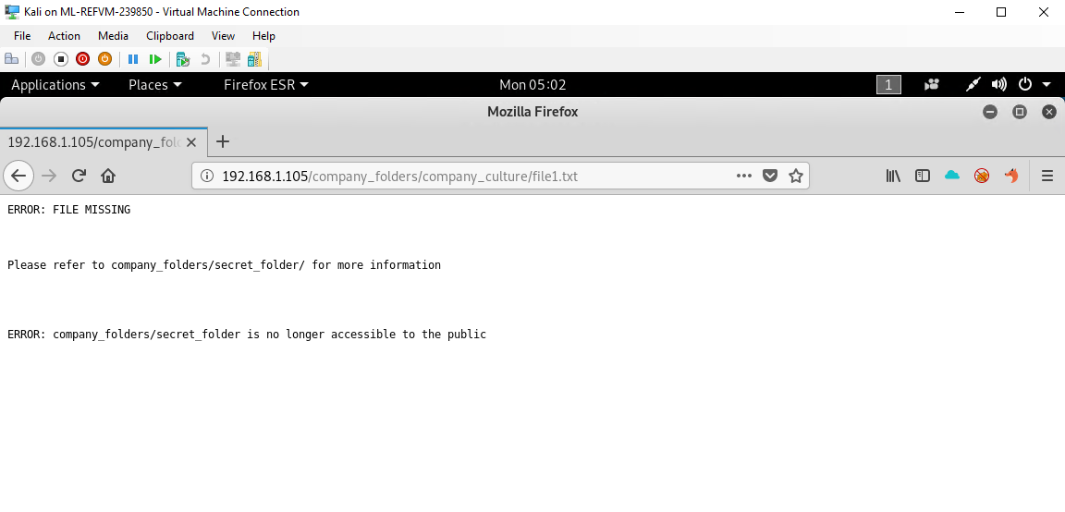
Directory Listing: Revealing Hidden “secret_folder”

Slide 12
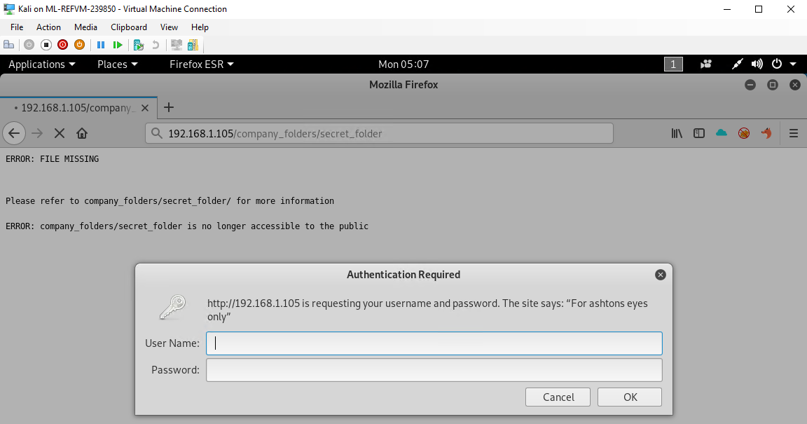
Directory Listing: Revealing Authentication of “secret_folder”

Slide 13

Exploitation: Brute Force Attack - Tool Hydra
01
02
03
In order to brute force this box and attempt to crack the password for the secret_folder directory I used the following Tool(s): Hydra
Using the rockyou.txt wordlist I was able to crack the password for the ashton account.
Username: ashton Password: leopoldo
hydra -l ashton -P /usr/share/wordlists/rockyou.txt -s 80 -f -vV 192.168.1.105 http-get /company_folders/secret_folder

Slide 14

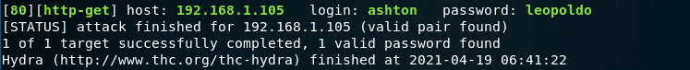
Command: root@kali:~# hydra -l ashton -P /usr/share/wordlists/rockyou.txt -s 80 -f -vV 192.168.1.105 http-get /company_folders/secret_folder

Slide 15
Exploitation: PHP File Inclusion
01
02
03
Tools & Processes
Once the brute force was successful I was able to login and view more sensitive information. Instructions on how to use Ryan’s account to access the webdav directory. Sensitive data was revealed with instructions how to access the webdav directory with ryans password hash. Using Crackstation.net I was able to decrypt his password.
Achievements
Once the password was cracked I was able to log into the following directory. “dav://192.168.1.105/webdav” And launch my reverse shell in order to gain better access to the system and install malware and other tools to maintain persistence before data exfiltration.
Launched crackstation.net site, cracked the password. Password: linux4u Copied Script to server: php.reverse-shell.php Opened listener on port 4444. root@kali:~#nc -lvnp 4444 Remotely executed script.

Slide 16
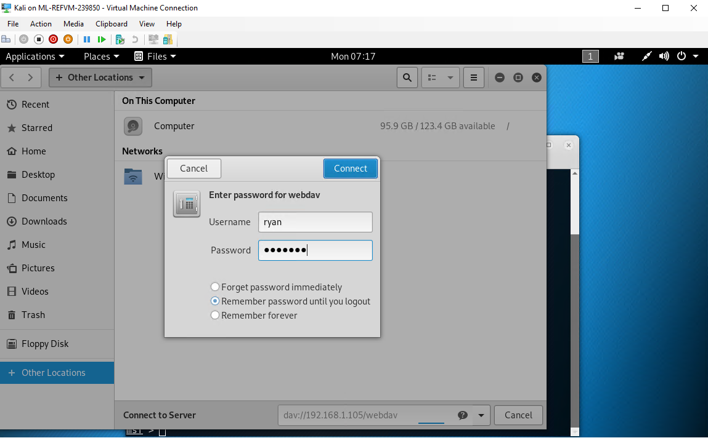

Slide 17
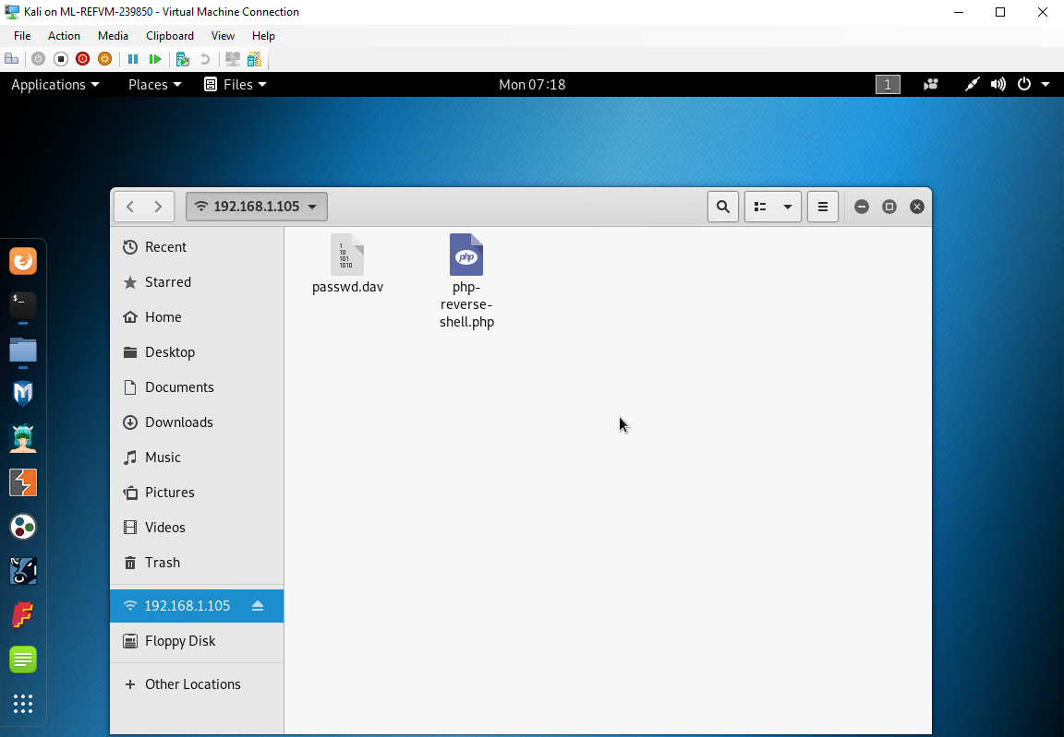

Slide 18
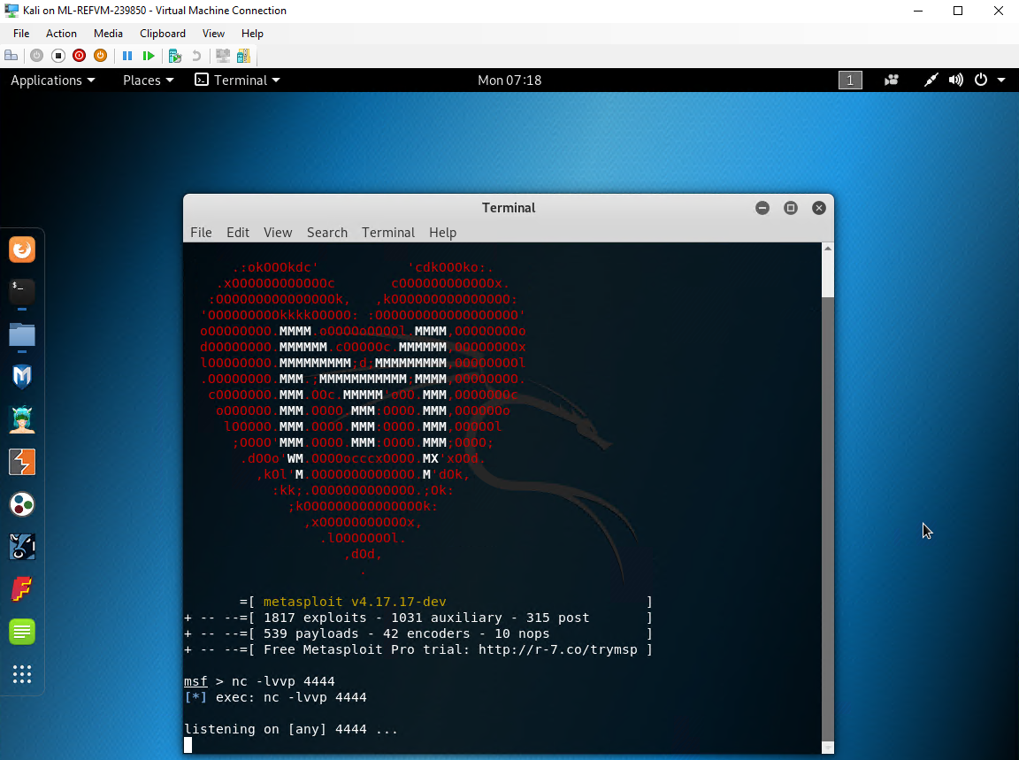

Slide 19
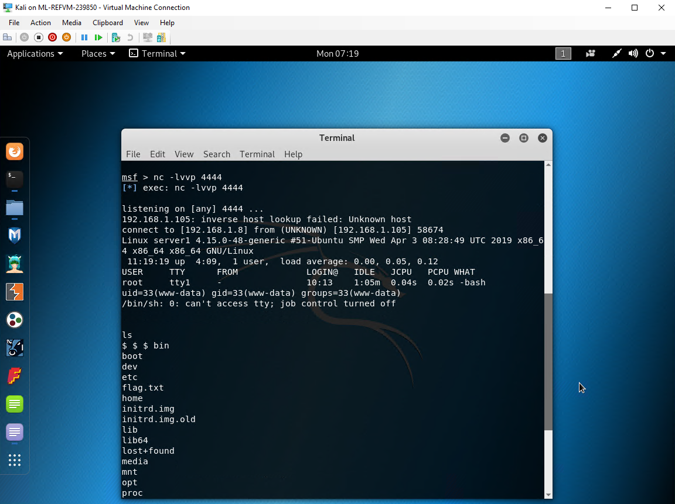

Slide 20
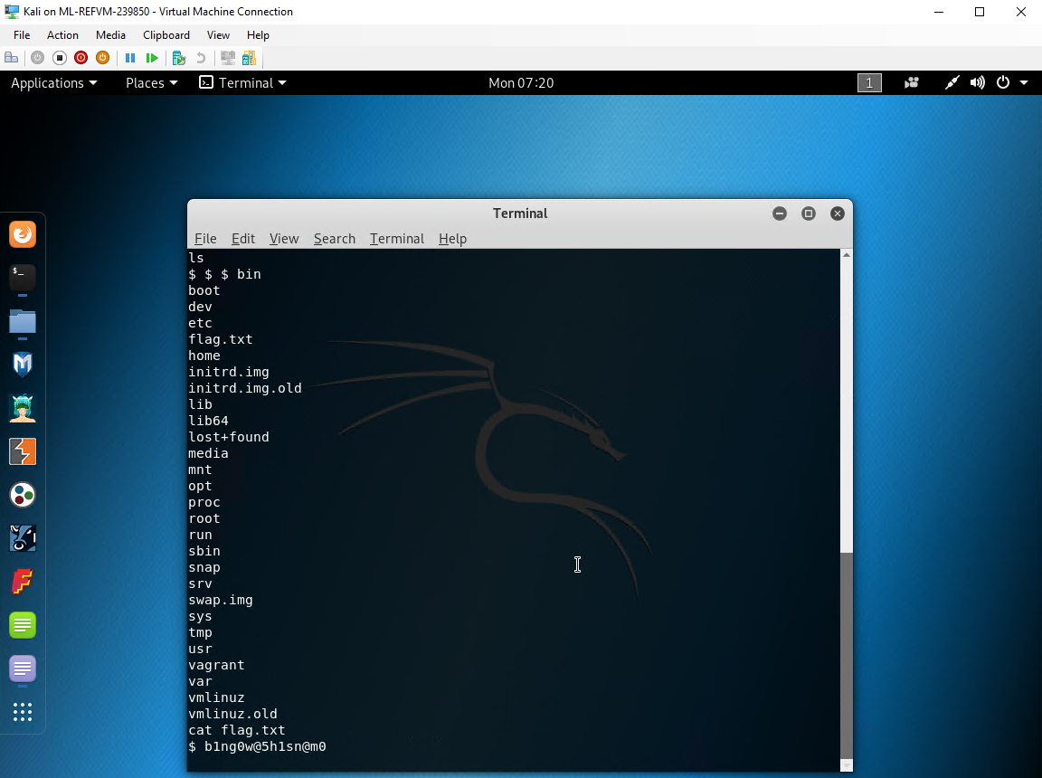

Slide 21

Blue Team
Log Analysis and Attack Characterization
21

Slide 22
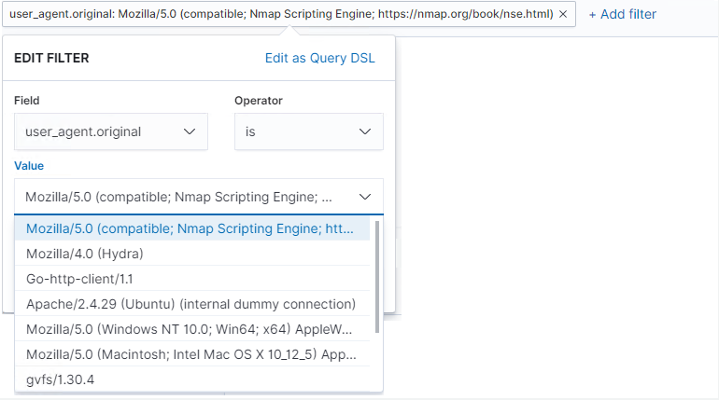
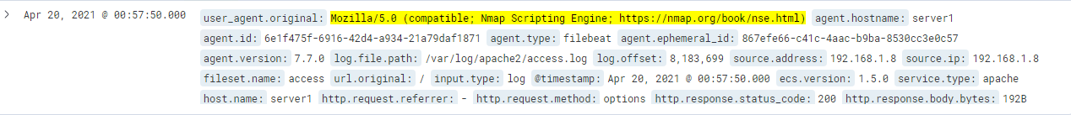
Analysis: Identifying the Port Scan
What time did the port scan occur? - Apr 20, 2021 @ 00:57:50 How many packets were sent, and from which IP? - 29 hits from the 192.168.1.8 IP Address What indicates that this was a port scan? - The user agent displays an Nmap scripting Engine was used. And 29 hits within a very short period of time.

Slide 23
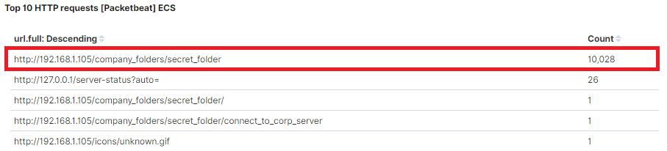
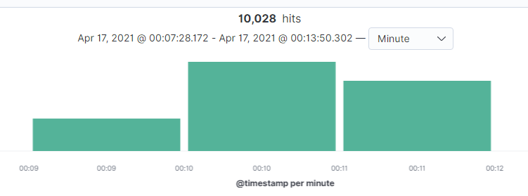
Analysis: Finding the Request for the Hidden Directory
What time did the request occur? How many requests were made? - Apr 17, 2021 @ 00:07:28, Total of 10,028 requests were made at this time. Which files were requested? What did they contain? Connect_to_corp_server which contained ashtons notes on how to connect using ryans credentials.

Slide 24
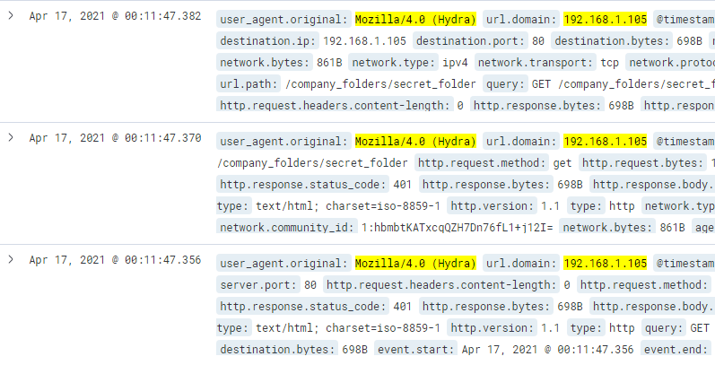
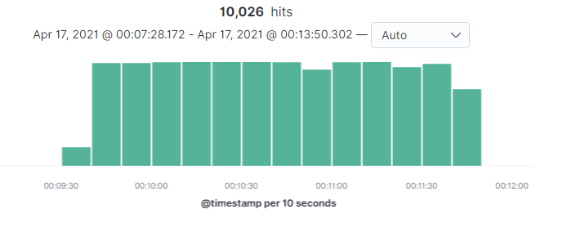
Analysis: Uncovering the Brute Force Attack
How many requests were made in the attack? -10,026 total attacks were made during this time. How many requests had been made before the attacker discovered the password? -10,010 requests made before a successful attempt.

Slide 25
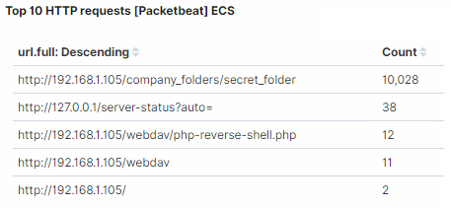
Analysis: Finding the WebDAV Connection
How many requests were made to this directory? -11 requests were made to this directory. Which files were requested? - the php-reverse-shell.php was requested

Slide 26
Blue Team
Proposed Alarms and Mitigation Strategies
26

Slide 27
Mitigation: Blocking the Port Scan
What kind of alarm can be set to detect future port scans?
An alarm that notifies when an unapproved ip address tries to scan.
The Threshold: Any time a new ip tries to scan, they’re probably trying to attack.
What configurations can be set on the host to mitigate port scans?
Make sure your firewall is dropping the packets rather than responding. Make sure the ports you aren't using are closed.
Describe the solution. If possible, provide required command lines.
You can set your firewall to honeypot server to be set up as a defence warning

Slide 28
Mitigation: Finding the Request for the Hidden Directory
What kind of alarm can be set to detect future unauthorized access?
An alarm that notifies anytime this directory is requested/accessed by an unauthorized user.
The Threshold: Any time there is an attempt from an employee or outsider that should not have access to the folder.
What configuration can be set on the host to block unwanted access?
Making sure that all users are in the correct groups and the only the users with access to the directory are viewing it
Describe the solution. If possible, provide required command lines.
Monitor anytime the hidden directory is accessed

Slide 29
Mitigation: Preventing Brute Force Attacks
What kind of alarm can be set to detect future brute force attacks?
A program that notifies when there is a substantial amount of logins happening at once.
The Threshold: If there have been 5 login attempts.
What configuration can be set on the host to block brute force attacks?
Two factor authentication, Limit failed login attempts, unique login urls.
Describe the solution. If possible, provide the required command line(s).

Slide 30
Mitigation: Detecting the WebDAV Connection
What kind of alarm can be set to detect future access to this directory?
Have the alarm notify when permissions are being modified.
The Threshold: Have the alert running to notify when anything has been changed unless there has been discussion of permission changes.
What configuration can be set on the host to control access?
Make sure you're using HTTPS as the transport system, which is fully encrypted and safe.
Make sure you have webdav authentication to keep your network secure.
Describe the solution. If possible, provide the required command line(s).

Slide 31
Mitigation: Identifying Reverse Shell Uploads
What kind of alarm can be set to detect future file uploads?
Make an alarm that tracks who uploads what files and don’t permit anyone who isn’t authorized to upload in the first place.
The Threshold:
If any of the file sizes change at all
What configuration can be set on the host to block file uploads?
Only allow specific file extensions, restrict file size, store files in a non public accessible directory
Describe the solution. If possible, provide the required command line.
Disable non specific users from uploading files

Slide 32

THE END

